Slide 1
Discrete Structures
Lecture No. 2
Spring 2020
Course Instructor: Amna Irum
National University of Computer and Emerging Sciences, Islamabad

Slide 2
Google Classroom Code :
l3uesnu

Slide 3
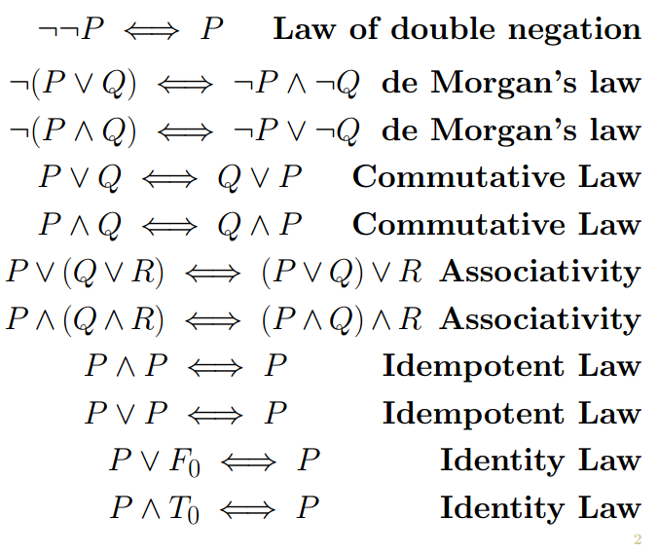
Laws of Logic

Slide 4
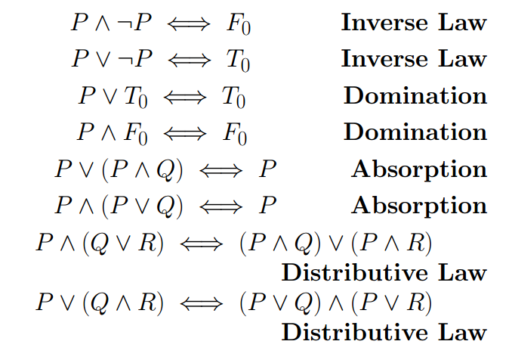
Laws of Logic

Slide 5
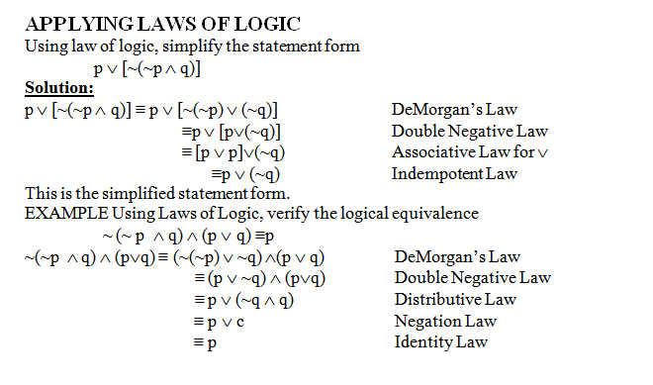

Slide 6
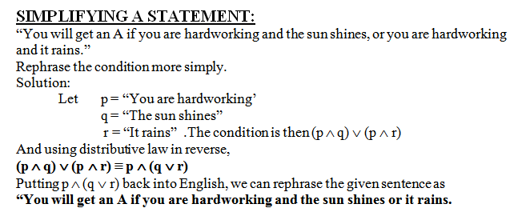

Slide 7
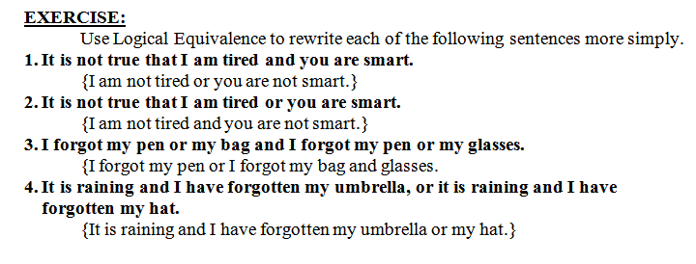

Slide 8
Conditional Statements
"If you earn an A in Math, then I'll buy you a computer."
This statement is made up of two simpler statements:
p: "You earn an A in Math," and
q: "I will buy you a computer."
The original statement is then saying:
if p is true, then q is true, or, more simply, if p, then q.
We can also phrase this as p implies q, and we write p → q.

Slide 9
Conditional Statements or Implications
If p and q are statement variables, the conditional of q by p is “If p then q”
or “p implies q” and is denoted p → q.
It is false when p is true and q is false; otherwise it is true.
The arrow "→ " is the conditional operator, and in p → q the statement p is called the hypothesis
(or antecedent) and q is called the conclusion (or consequent).

Slide 10
Truth Table
p | q | p → q
T | T | T
T | F | F
F | T | T
F | F | T

Slide 11
PRACTICE WITH CONDITIONAL STATEMENTS:
Determine the truth value of each of the following conditional statements:
1. “If 1 = 1, then 3 = 3.” TRUE
2. “If 1 = 1, then 2 = 3.” FALSE
3. “If 1 = 0, then 3 = 3.” TRUE
4. “If 1 = 2, then 2 = 3.” TRUE
5. “If 1 = 1, then 1 = 2 and 2 = 3.” FALSE
6. “If 1 = 3 or 1 = 2 then 3 = 3.” TRUE

Slide 12
ALTERNATIVE WAYS OF EXPRESSING IMPLICATIONS
The implication p → q could be expressed in many alternative ways as:
“if p then q” •“not p unless q”
“p implies q” •“q follows from p”
“if p, q” •“q if p”
“p only if q” •“q whenever p”
“p is sufficient for q” •“q is necessary for p”

Slide 13
Exercise
Write the following statements in the form “if p, then q” in English.
a) Your guarantee is good only if you bought your CD less than 90 days ago.
If your guarantee is good, then you must have bought your CD player less than 90 days ago.
b) To get tenure as a professor, it is sufficient to be world-famous.
If you are world-famous, then you will get tenure as a professor.
c) That you get the job implies that you have the best credentials.
If you get the job, then you have the best credentials.
d) It is necessary to walk 8 miles to get to the top of the Peak.
If you get to the top of the peak, then you must have walked 8 miles.

Slide 14
TRANSLATING ENGLISH SENTENCES TO SYMBOLS
:
Let p and q be propositions:
p = “you get an A on the final exam”
q = “you do every exercise in this book”
r = “you get an A in this class”
Write the following propositions using p, q, and r and logical connectives.
1. To get an A in this class it is necessary for you to get an A on the final.
SOLUTION p → r
2. You do every exercise in this book; You get an A on the final, implies,
you get an A in the class.
SOLUTION p ∧ q → r
3. Getting an A on the final and doing every exercise in this book is sufficient for getting an A in this class.
SOLUTION : p ∧ q → r

Slide 15
TRANSLATING SYMBOLIC PROPOSITIONS TO ENGLISH
:
Let p, q, and r be the propositions:
p = “you have the flu”
q = “you miss the final exam”
r = “you pass the course”
Express the following propositions as an English sentence.
1. p → q: If you have flu, then you will miss the final exam.
2.~q → r:If you don’t miss the final exam, you will pass the course.
3.~p ∧ ~q→ r
If you neither have flu nor miss the final exam, then you will pass the course.

Slide 16
HIERARCHY OF OPERATIONS
FOR LOGICAL CONNECTIVES
~ (negation)
∧ (conjunction), ∨ (disjunction)
→ (conditional)

Slide 17
Construct a truth table for the statement form p ∨ ~ q → ~ p
p
q
~q
~p
p ∨ ~q
p ∨ ~ q → ~ p
T
T
F
F
T
F
T
F
T
F
T
F
F
T
F
T
F
T
F
F
T
T
T
T

Slide 18
LOGICAL EQUIVALENCE INVOLVING IMPLICATION
Use truth table to show p→q ≡ ~q → ~p
p | q | ~q | ~p | p→q | ~q → ~p
T | T | F | F | T | T
T | F | T | F | F | F
F | T | F | T | T | T
F | F | T | T | T | T

Slide 19
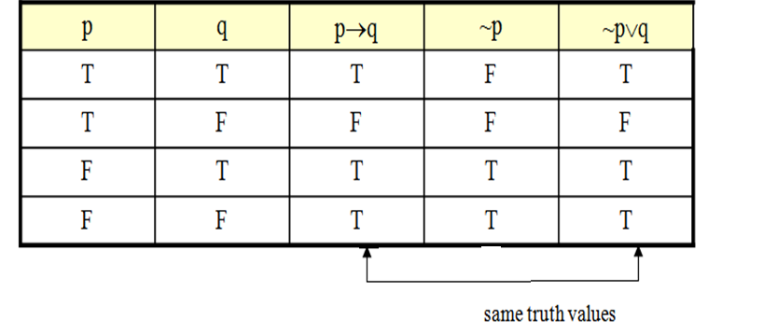
IMPLICATION LAW

Slide 20
NEGATION OF A CONDITIONAL STATEMENT
Since p→q ≡ ~p∨q therefore
~ (p → q) ≡ ~ (~ p ∨ q)
≡ ~ (~ p) ∧ (~ q) by De Morgan’s law
≡ p ∧ ~ q by the Double Negative law
Thus the negation of “if p then q” is logically equivalent to “p and not q”.
Accordingly, the negation of an if-then statement does not start with the word if.

Slide 21
EXAMPLES
Write negations of each of the following statements:
1. If Ali lives in Pakistan then he lives in Lahore.
2. If my car is in the repair shop, then I cannot get to class.
3. If x is prime then x is odd or x is 2.
4. If n is divisible by 6, then n is divisible by 2 and n is divisible by 3.

Slide 22
1. Ali lives in Pakistan and he does not live in Lahore.
2. My car is in the repair shop and I can get to class.
3. x is prime but x is not odd and x is not 2.
4. n is divisible by 6 but n is not divisible by 2 or by 3.

Slide 23
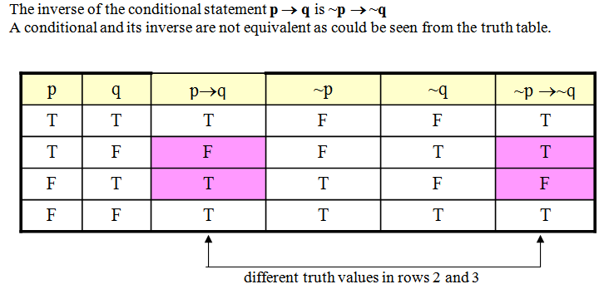
INVERSE OF A CONDITIONAL STATEMENT

Slide 24
WRITING INVERSE
:
1. If today is Friday, then 2 + 3 = 5.
If today is not Friday, then 2 + 3 ≠ 5.
2. If it snows today, I will ski tomorrow.
If it does not snow today I will not ski tomorrow.
3. If P is a square, then P is a rectangle.
If P is not a square then P is not a rectangle.
4. If my car is in the repair shop, then I cannot get to class.
If my car is not in the repair shop, then I shall get to the class.

Slide 25
CONVERSE OF A CONDITIONAL STATEMENT
:
The converse of the conditional statement p → q is q →p
A conditional and its converse are not equivalent. i.e., → is not a commutative operator.
p | q | p→q | q→p
T | T | T | T
T | F | F | T
F | T | T | F
F | F | T | T

Slide 26
WRITING CONVERSE
:
1.If today is Friday, then 2 + 3 = 5.
If 2 + 3 = 5, then today is Friday.
2.If it snows today, I will ski tomorrow.
I will ski tomorrow only if it snows today.
3. If P is a square, then P is a rectangle.
If P is a rectangle then P is a square.
4. If my car is in the repair shop, then I cannot get to class.
If I cannot get to the class, then my car is in the repair shop.

Slide 27
CONTRAPOSITIVE OF A CONDITIONAL STATEMENT
:
The contrapositive of the conditional statement p → q is~ q → ~ p
A conditional and its contrapositive are equivalent.
Symbolically p→q ≡ ~q → ~p
1. If today is Friday, then 2 + 3 = 5.
If 2 + 3 ≠ 5, then today is not Friday.
2. If it snows today, I will ski tomorrow.
I will not ski tomorrow only if it does not snow today.
3. If P is a square, then P is a rectangle.
If P is not a rectangle then P is not a square.
4. If my car is in the repair shop, then I cannot get to class.
If I get to the class, then my car is not in the repair shop.

